Slide 1

SOFTWARE ENGINEERING PROJECT (CS331)
HOMEBAZAAR(REAL ESTATE APPLICATION)
GROUP : G9
GROUP MEMBERS:
Shivam Sahu(1901188)
Om Prakash(1901125)
Mritunjay Kumar(1901115)

Slide 2
TESTING REPORT
(BLACK-BOX TESTING)

Slide 3
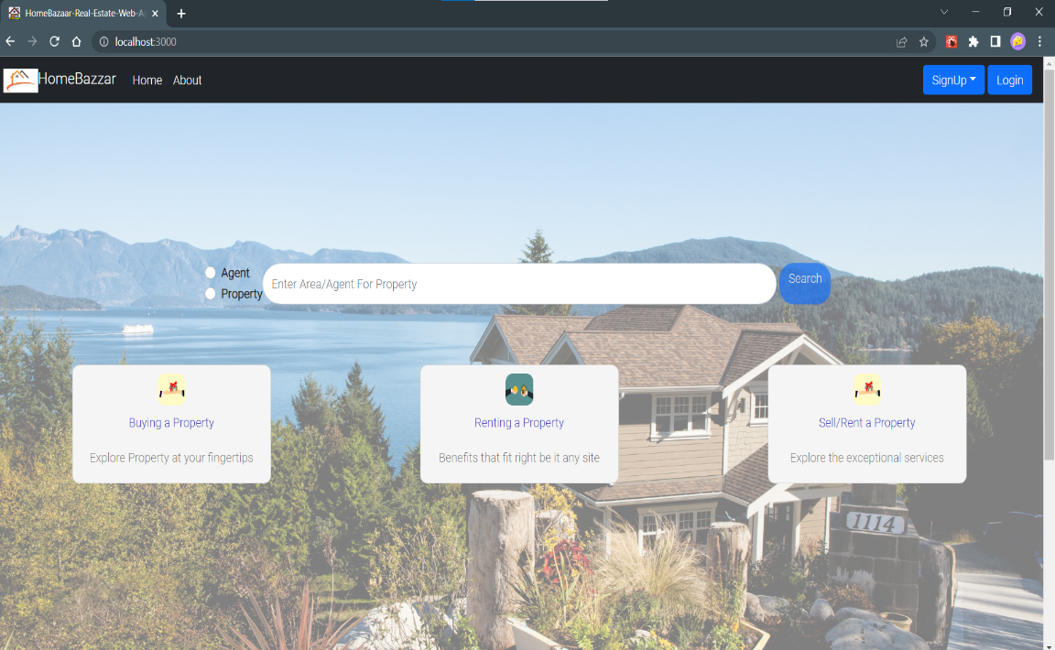
TEST-1 (Home page)
Index Route (“/ ”)
Login (“/login”) : The login route allows the user to login into the Application.
Signup ( “/signup”) : The signup route allow new users to register onto the application.
Search
(“/apartmentResult”) : This route shows the matched(area) apartments.
(“/agentResult”) : This route shows agents available in area.

Slide 4
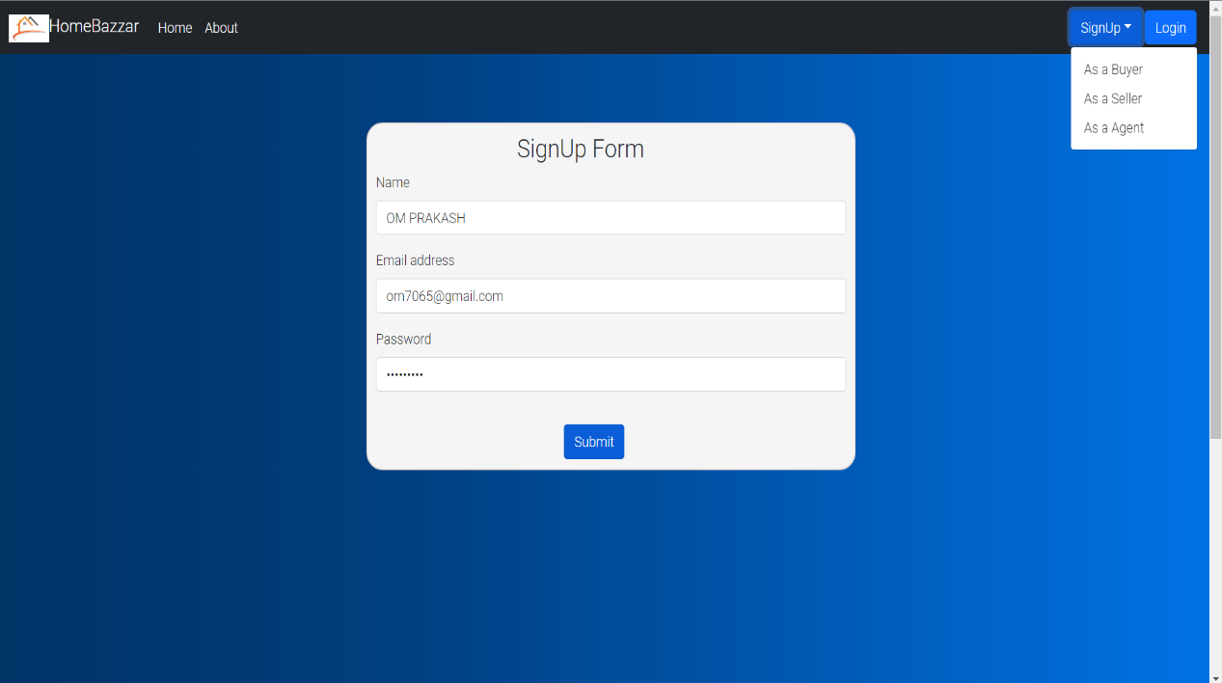
TEST-2 (BUYER/SELLER SIGNUP)
SignUp Route (“/{userType}signup ”)
VALID INPUTS:
INPUT
Name length must be at least of two characters.
Email Id must be unique and in valid format.
Password length must be of at least five characters.
NOTE: Signup page and its input for buyer and seller is same.

Slide 5
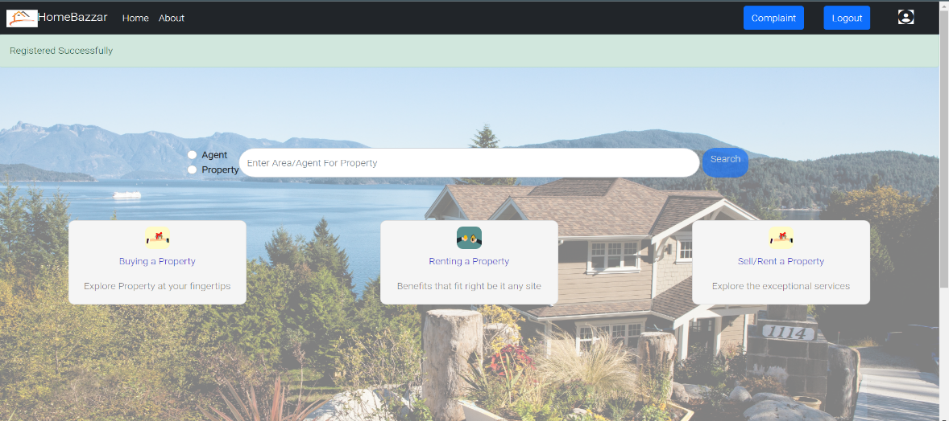
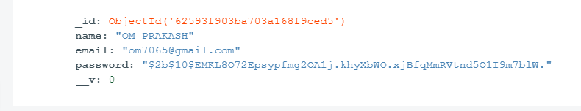
TEST-2 (BUYER/SELLER SIGNUP)
OUTPUT:
User will get a success notification if all inputs are valid and will be navigated to the homepage.
After successful submission of registration form user details will get stored in the database.

Slide 6
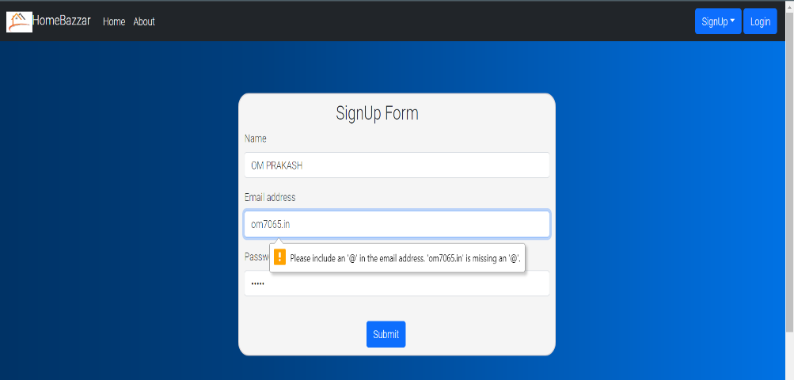
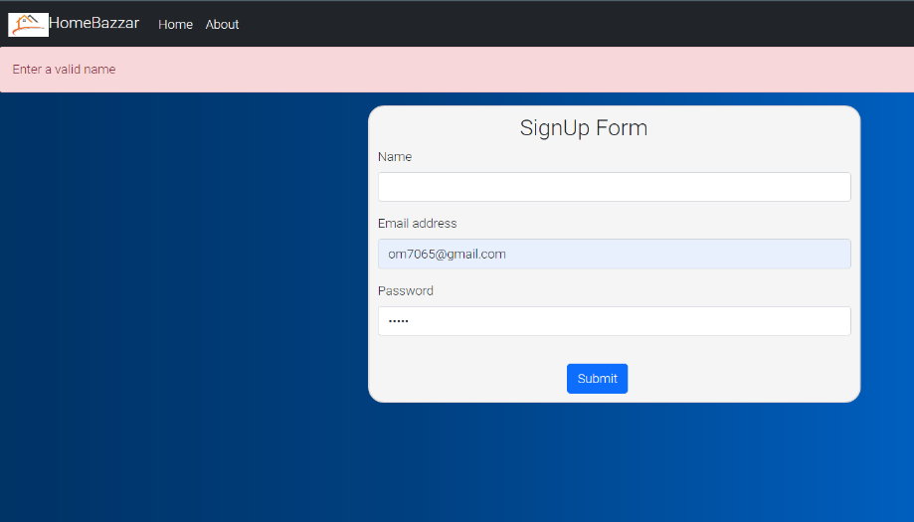
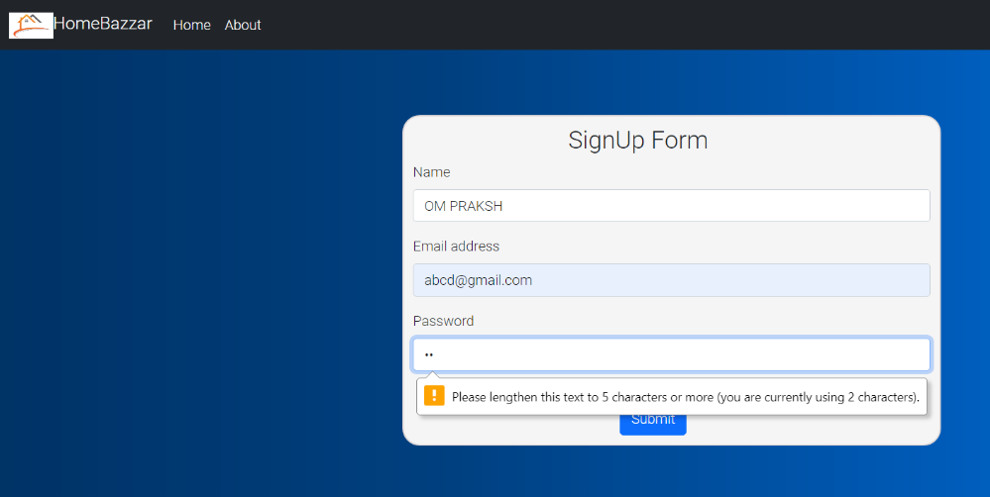
TEST-2 (BUYER/SELLER SIGNUP)
INVALID INPUTS:
When user gives invalid inputs he/she will get notification about what inputs are invalid.

Slide 7
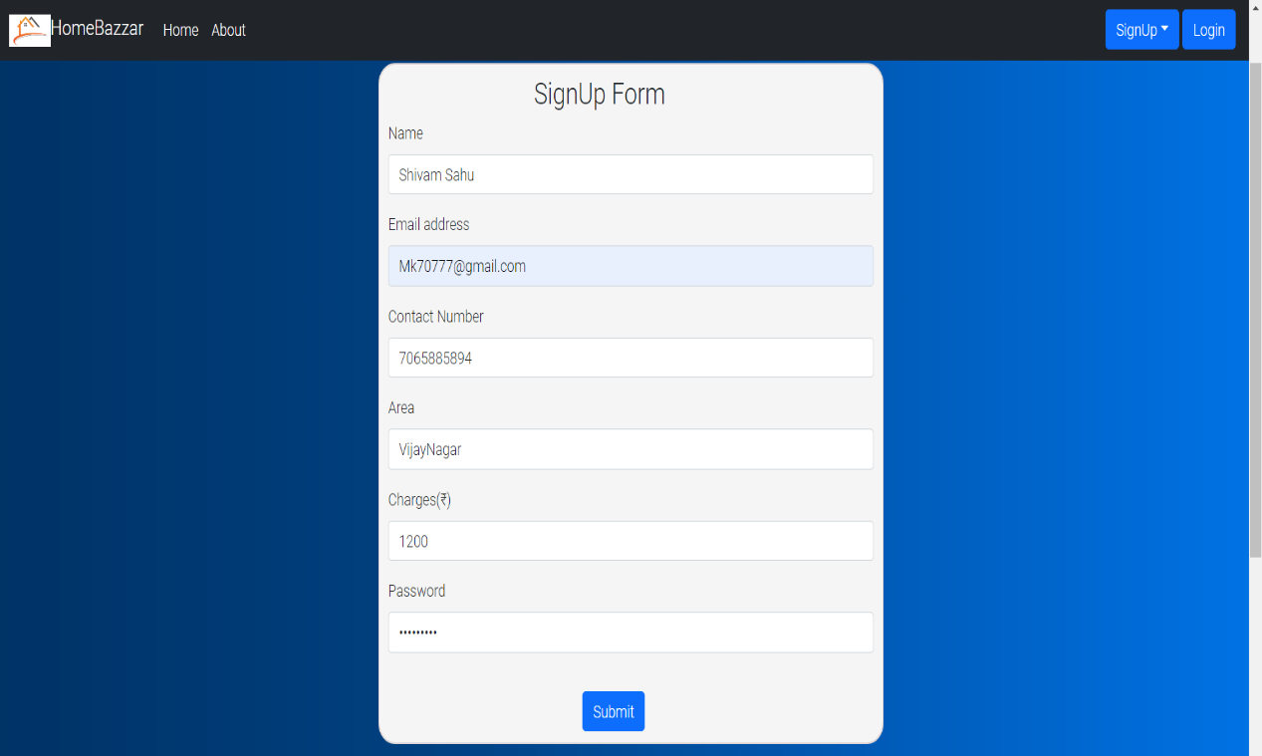
TEST-3 (AGENT SIGNUP)
SignUp Route (“/agentsignup ”)
VALID INPUTS:
INPUT
Name length must be at least of two characters.
Area length must be at least of two characters.
Email Id must be unique and in valid format.
Password length must be of at least five characters.
Phone Number length must be of length 10 and must be a number.
Charges must be a number(greater than zero).

Slide 8
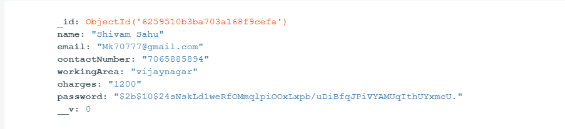
TEST-3 (AGENT SIGNUP)
OUTPUT:
User will get a success notification if all inputs are valid and will be navigated to the homepage.
After successful submission of registration form user details will get stored in the database.

Slide 9
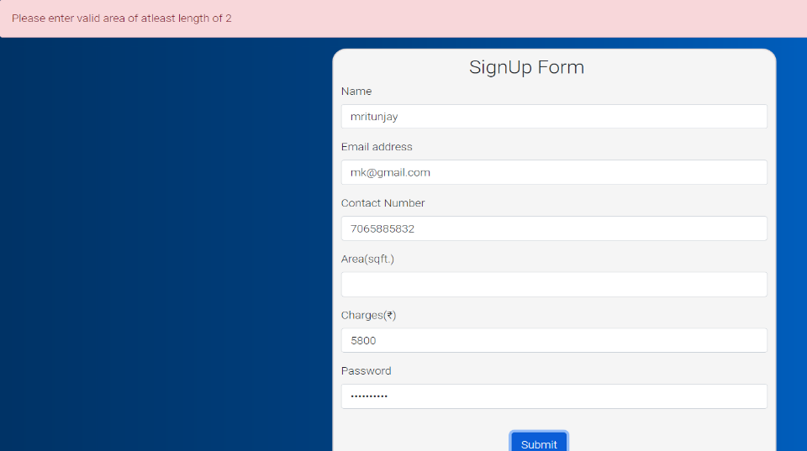

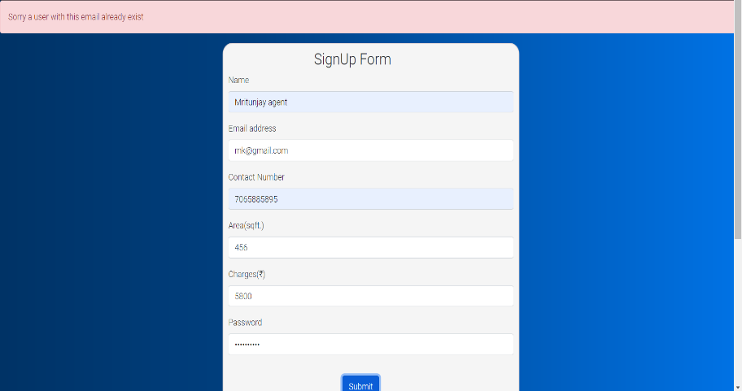
TEST-3 (AGENT SIGNUP)
INVALID INPUTS:
When user gives invalid inputs he/she will get notification about what inputs are invalid.

Slide 10
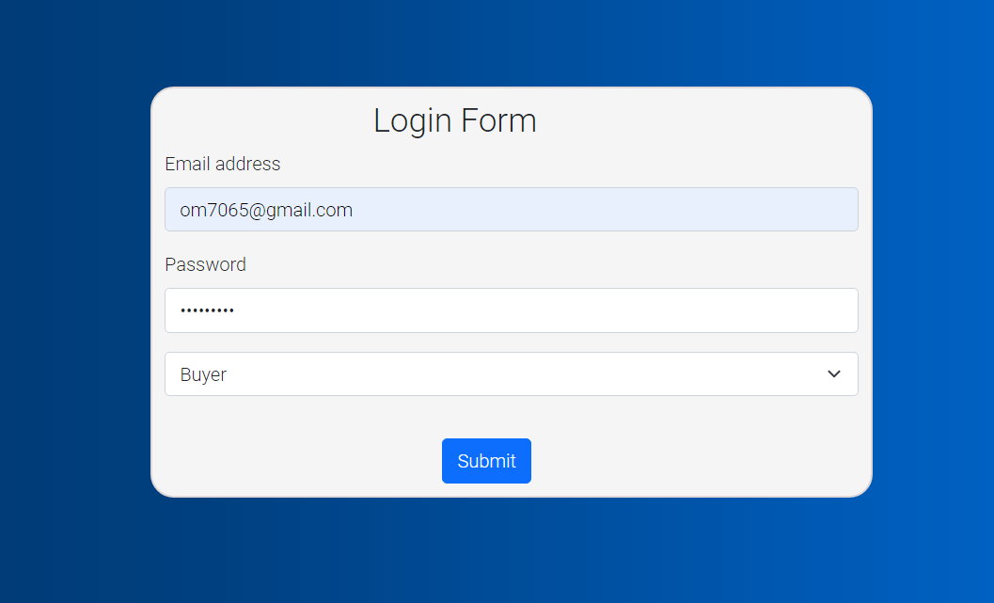
TEST-4 (login)
Login Route (“/login”)
VALID CREDENTIALS
INPUT:
Correct email and password
NOTE: Login Page for seller/buyer/agent or admin is same.

Slide 11

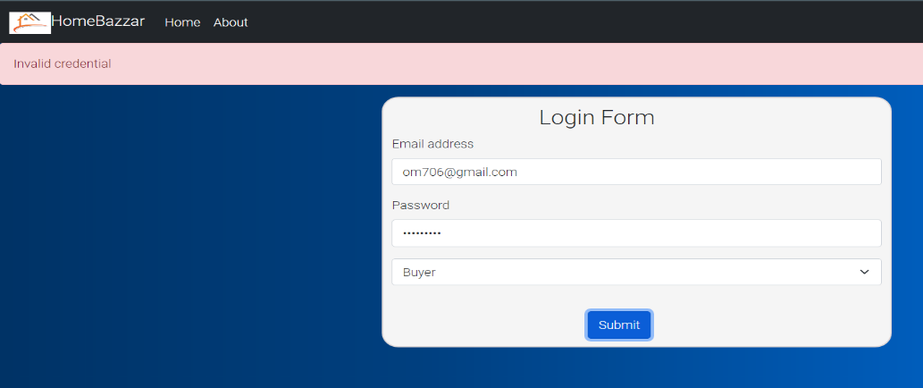
TEST-4 (login)
Login Route (“/login”)
OUTPUT:
If credentials are correct then user will be navigated to homepage.
INVALID CREDENTIALS
INPUT:
Wrong credentials entered.
OUTPUT:
User will stay at the login page

Slide 12
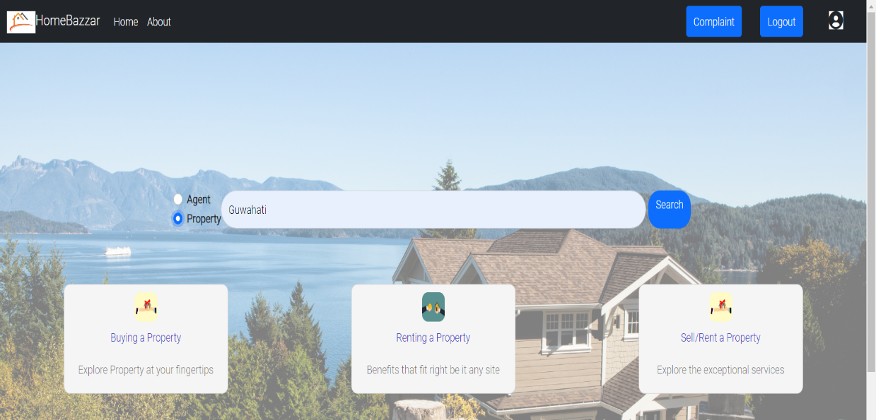
TEST-5 (SEARCHING APARTMENTS)
Searching Route (“/”)
VALID INPUT
INPUT:
Area is entered in text format

Slide 13
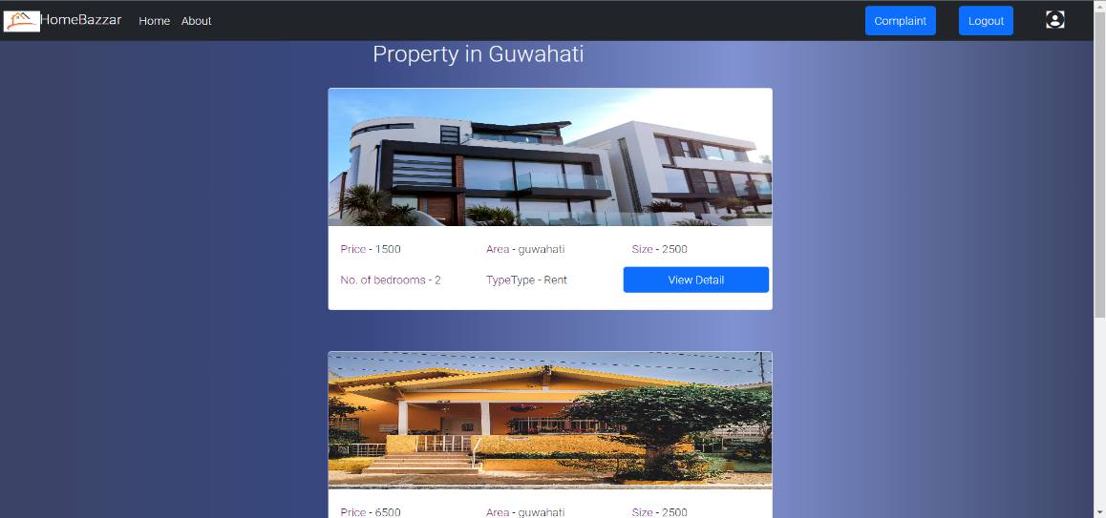
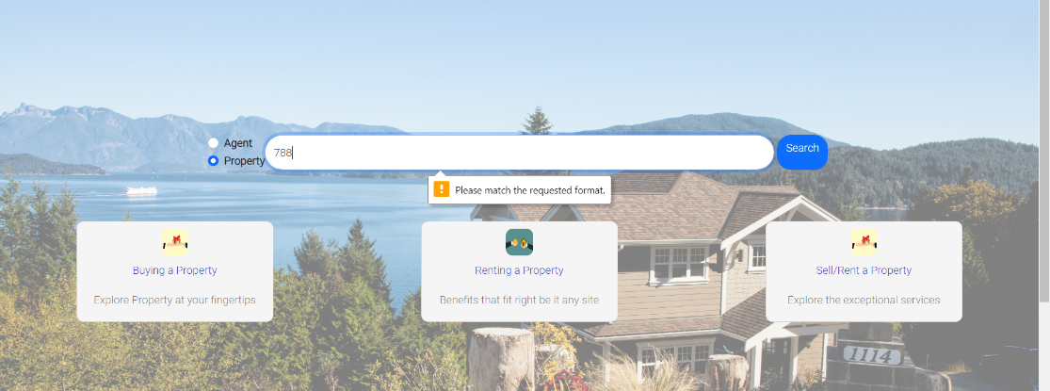
TEST-4 (SEARCHING APARTMENTS)
Matched apartments Route (“/apartmentResult”)
OUTPUT:
List of apartments found in the area provided by the user.
INVALID INPUT
INPUT:
Area entered is not in text format.
OUTPUT:
User will stay at the homepage

Slide 14
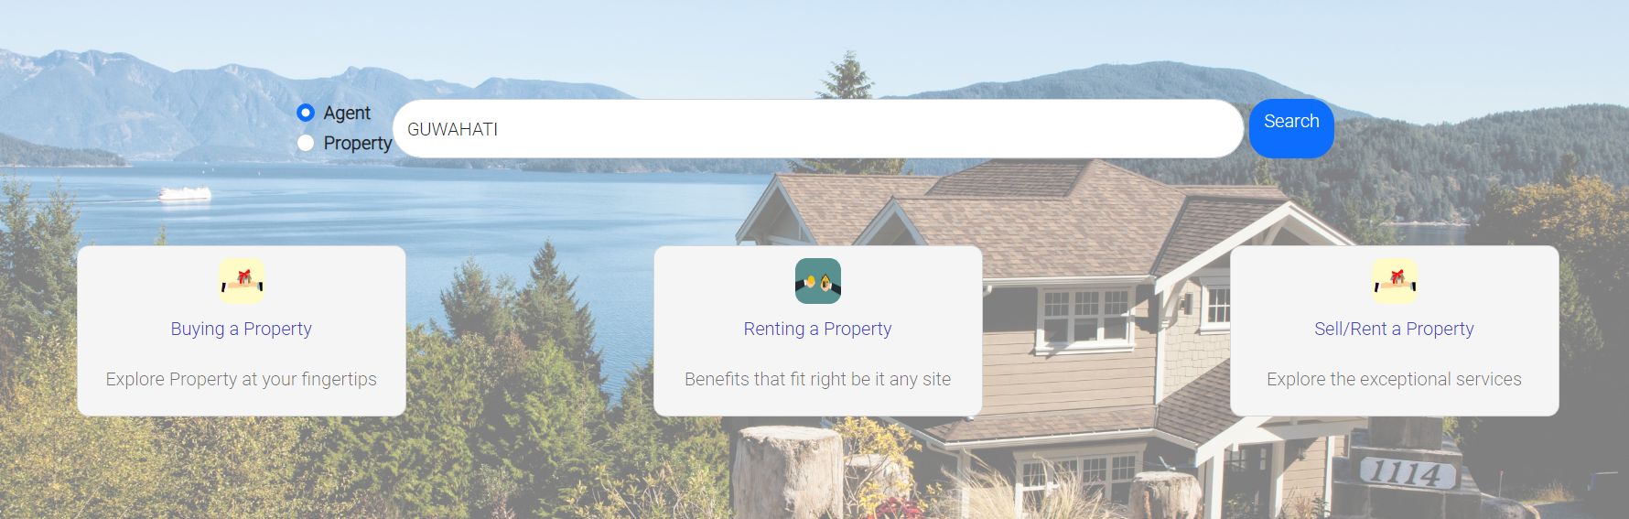
TEST-5 (SEARCHING AGENTS)
Searching Route (“/”)
VALID INPUT
INPUT:
Area is entered in text format.

Slide 15
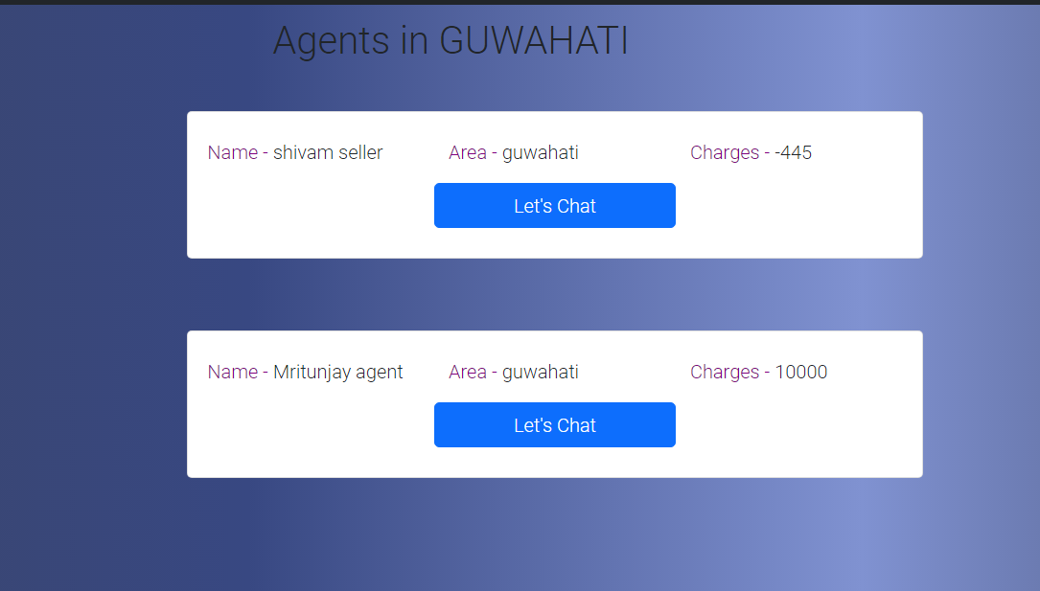
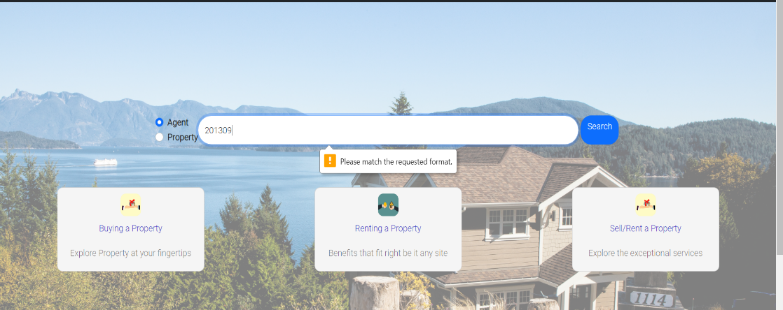
TEST-5 (SEARCHING AGENTS)
Matched agents Route (“/agentResult”)
OUTPUT:
List of agents found in the area provided by the user.
INVALID INPUT
INPUT:
Area entered is not in text format.
OUTPUT:
User will stay at the homepage

Slide 16
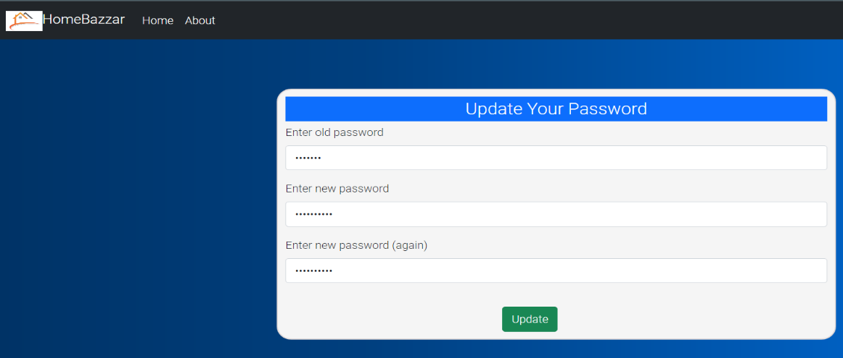
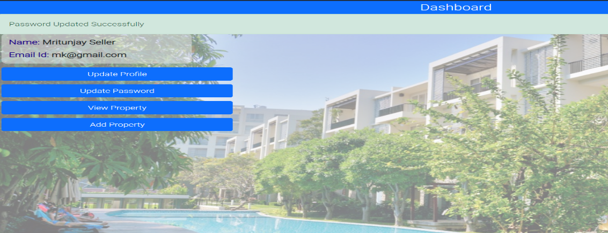
TEST-6 (UPDATING PASSWORD)
Update Password Route (“/{userType}/update-password”)
VALID INPUT
INPUT:
Correct old password and matching new password and confirm password
OUTPUT:
Password updated successful then user is navigated to his/her dashboard

Slide 17
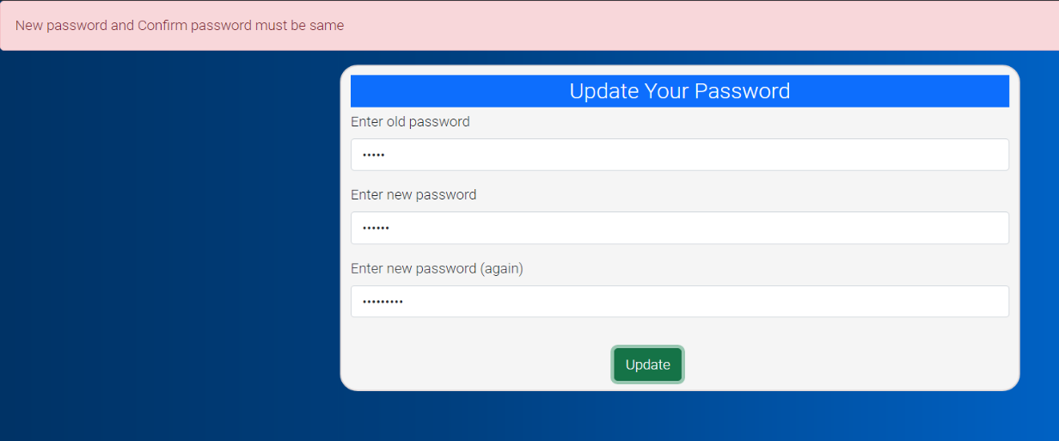
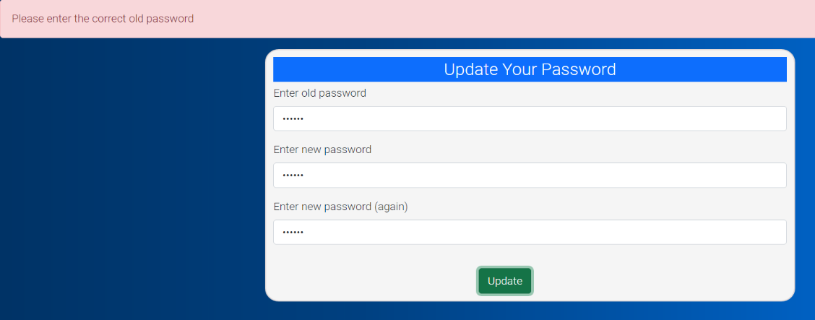
TEST-6 (UPDATING PASSWORD)
Update Password Route (“/{userType}/update-password”)
INVALID INPUT
INPUT:
Wrong old password or new password and confirm password didn’t matches.
OUTPUT: When user gives invalid inputs he/she will get notification about what inputs are invalid.

Slide 18
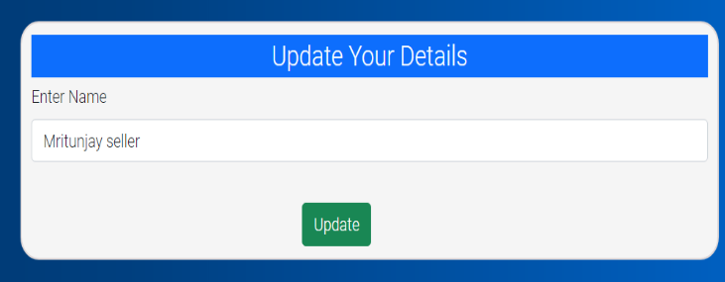
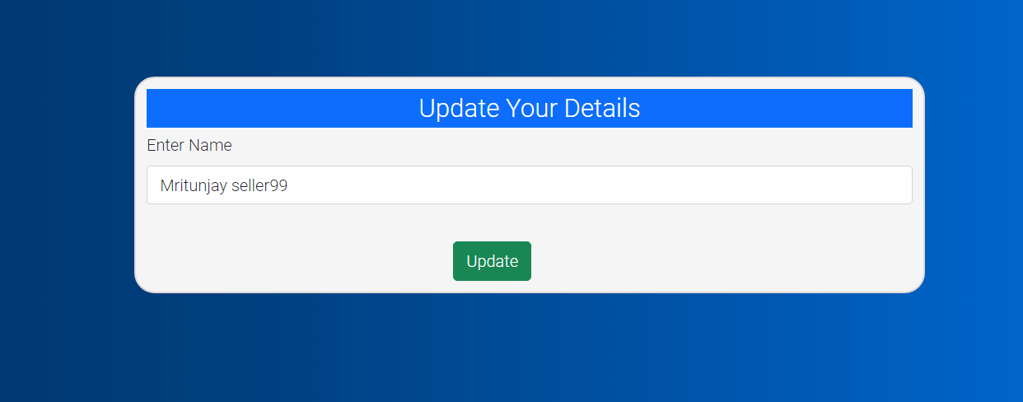
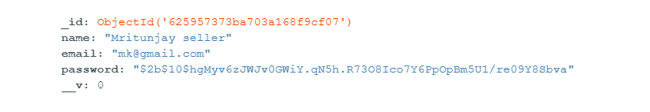
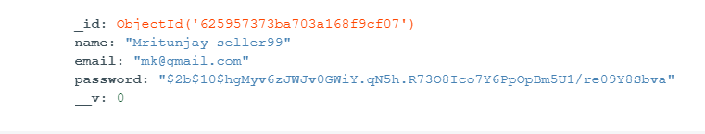
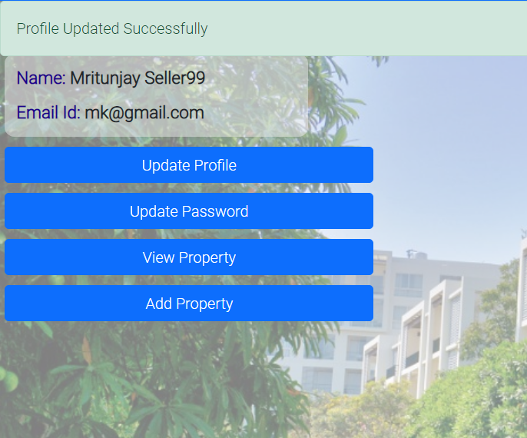
TEST-7 (UPDATING PROFILE)
Update Password Route (“/{userType}/update-profile”)
OLD PROFILE
NEW PROFILE
INPUT
New Name that user want to set.
OUTPUT
Profile updated successful(notification) then user is navigated to his/her dashboard

Slide 19
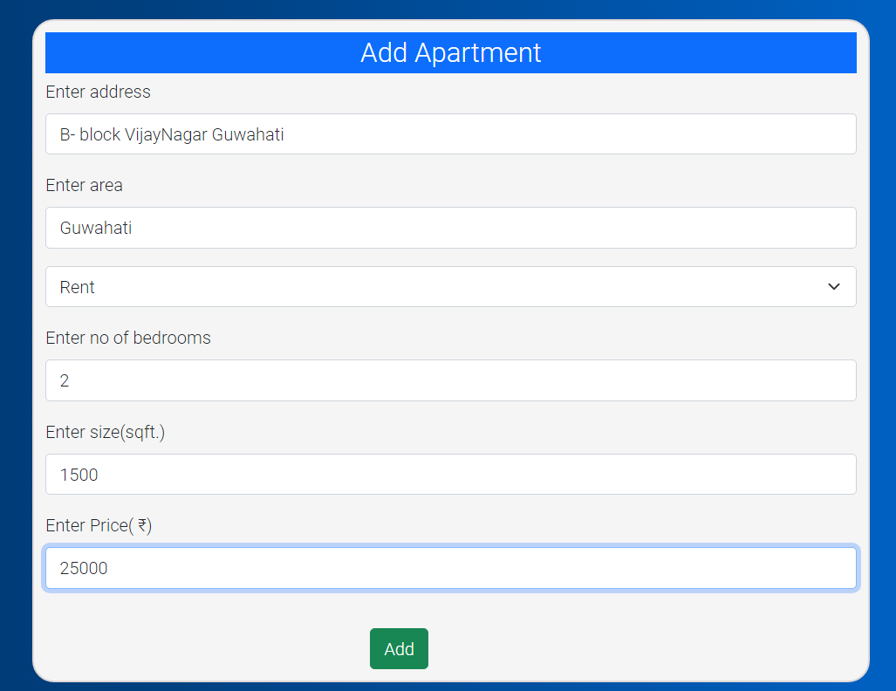
TEST-8 (ADDING APARTMENT)
Add Apartment Route (“/seller/add-apartment”)
VALID INPUTS:
INPUT
Address length must be at least of ten characters.
Area length must be at least of 3 characters.
Type of apartment selection is mandatory
No. of Bedrooms cannot be negative.
Size of apartments cannot be negative.
Price of apartment cannot be negative.

Slide 20
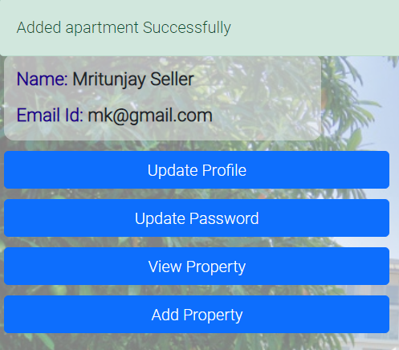
TEST-8 (ADDING APARTMENT)
Add Apartment Route (“/seller/add-apartment”)
OUTPUT:
User will get success notification and navigated to his/her dashboard
INVALID INPUT
INPUT:
Area entered is not in text format.
OUTPUT:
User will stay at the homepage

Slide 21
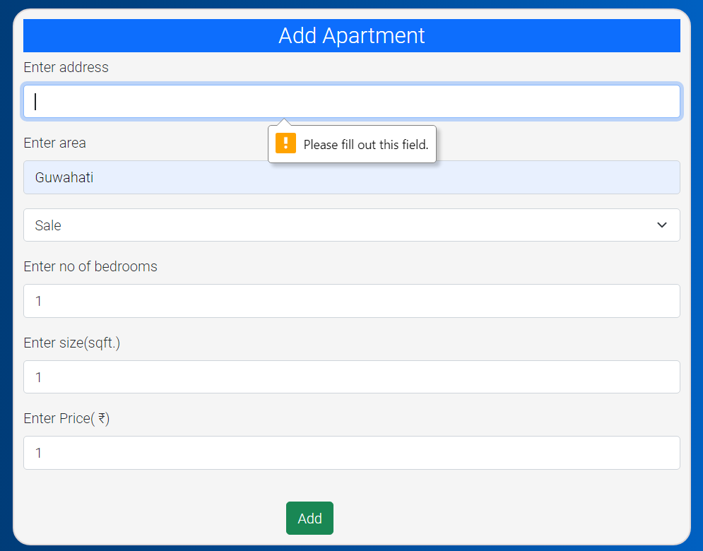
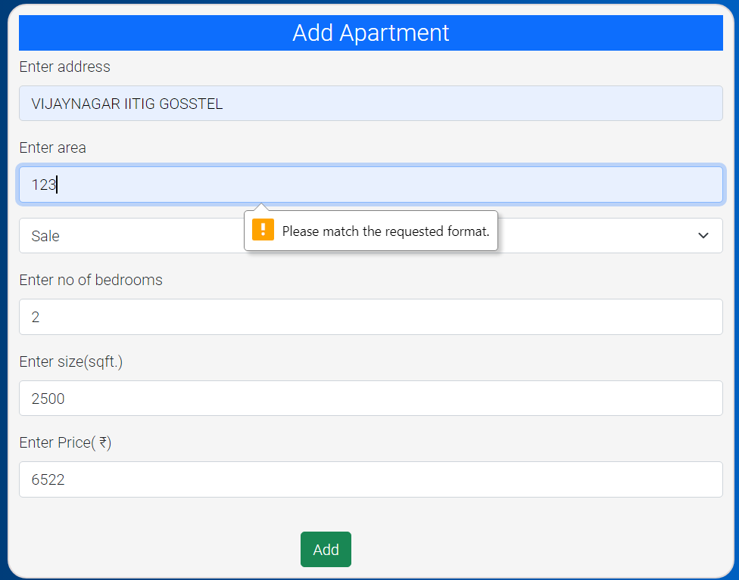
TEST-8 (ADDING APARTMENT)
Add Apartment Route (“/seller/add-apartment”)
INVALID INPUTS:
When user gives invalid inputs he/she will get notification about what inputs are invalid.

Slide 22
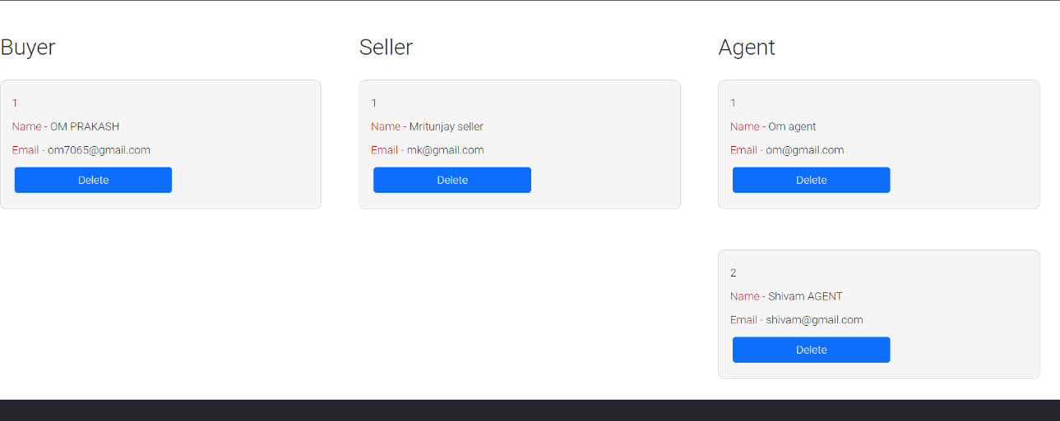
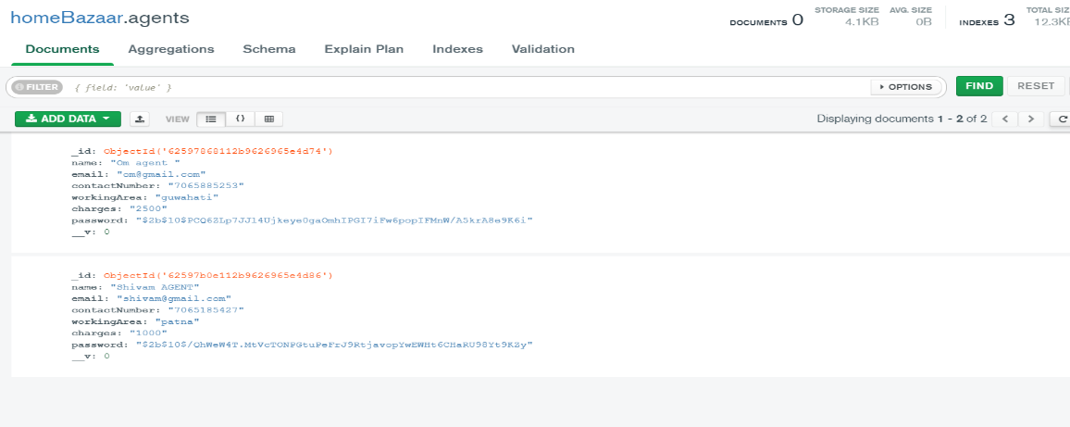
TEST-9 (Manage users)
Manage Users Route (“/admin/manage-users”)
INPUT:
When ADMIN clicks on delete button of any user.
Agent’s database before deletion by admin.

Slide 23
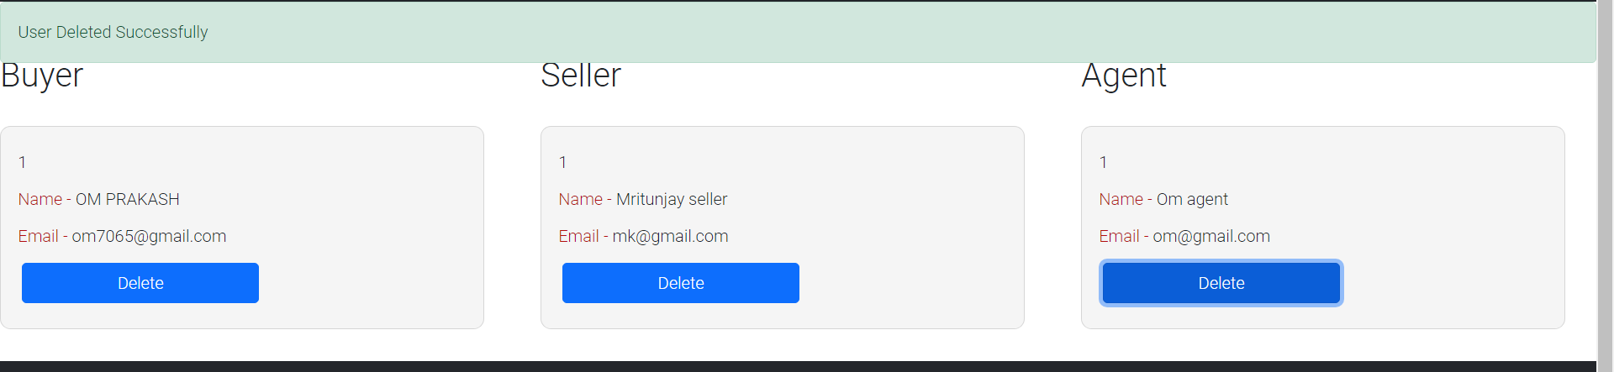
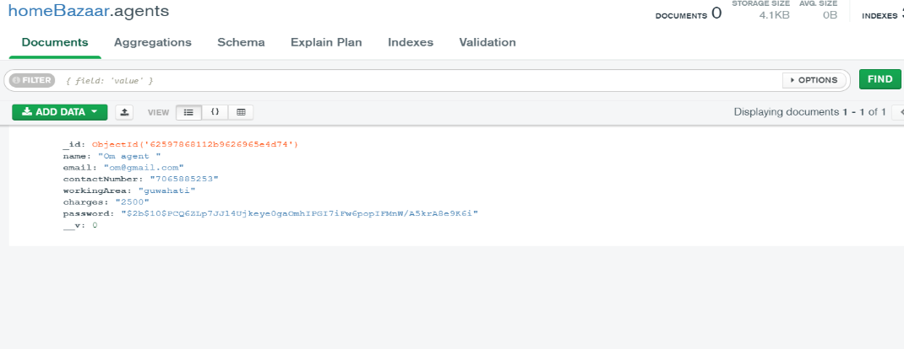
TEST-9 (Manage users)
Manage Users Route (“/admin/manage-users”)
OUTPUT:
A success user deleted notification will be shown to admin.
Agent’s database after admin deleted an agent.

Slide 24
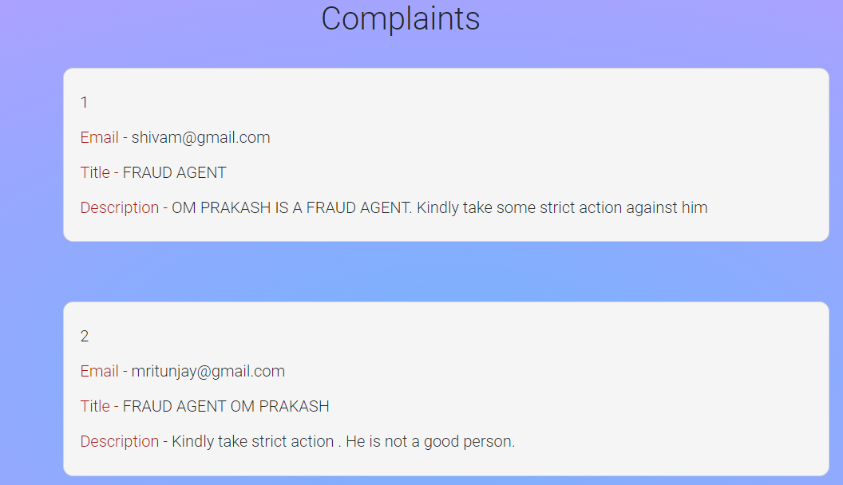
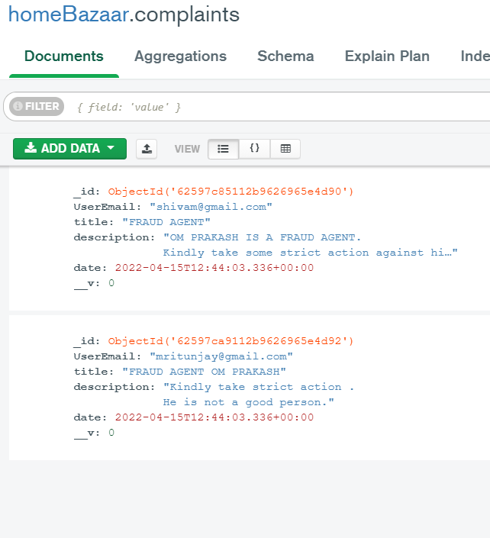
TEST-10 (VIEW COMPLAINTS)
View Complaints Route (“/admin/view-complaints”)
INPUT:
When ADMIN clicks on View complaints button on his/her dashboard.
Complaint database:

Slide 25
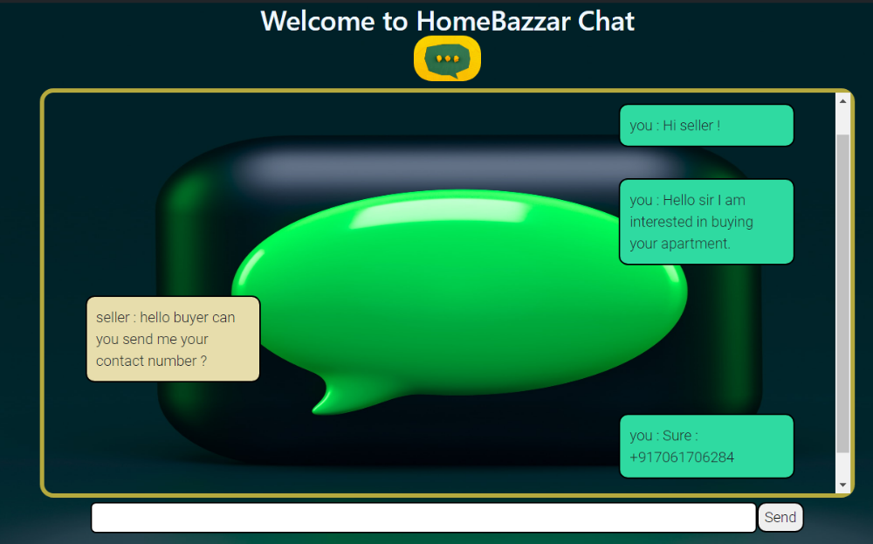
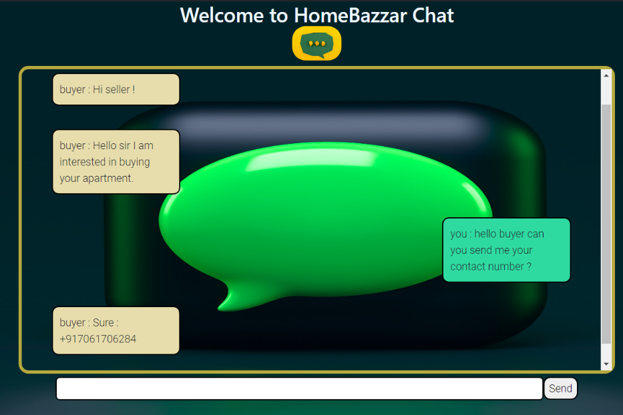
TEST-11 (CHAT FEATURE)
CHAT Route (“/chat”)
BUYER CHATs
SELLER CHATs

Slide 26
AFTER TESTING, IT IS CONCLUDED THAT ALL THE REQUIRED FUNCTIONAL REQUIREMENTS WERE MET AND THE SYSTEM BEHAVIOUR IS CONSISTENT WITH THE SRS

